Slide 1
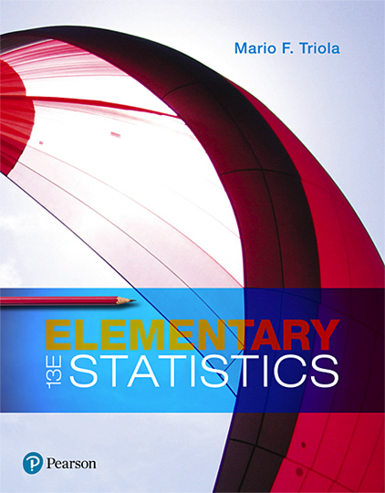
Elementary Statistics
Thirteenth Edition
Chapter 6
Normal Probability Distributions
Copyright © 2018, 2014, 2012 Pearson Education, Inc. All Rights Reserved

Slide 2
Normal Probability Distributions
6-1 The Standard Normal Distribution
6-2 Real Applications of Normal Distributions
6-3 Sampling Distributions and Estimators
6-4 The Central Limit Theorem
6-5 Assessing Normality
6-6 Normal as Approximation to Binomial

Slide 3
Key Concept
This section presents methods for working with normal distributions that are not standard. That is, the mean is not 0 or the standard deviation is not 1, or both.
The key is that we can use a simple conversion that allows us to “standardize” any normal distribution so that the same methods of the previous section can be used.

Slide 4

Conversion Formula
(round z scores to 2 decimal places)
The formula allows us to “standardize” any normal distribution so that x values can be transformed to z scores.

Slide 5
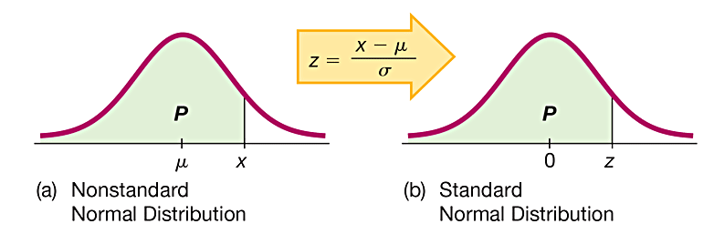
Converting to a Standard Normal Distribution
The figures illustrate the conversion from a nonstandard to a standard normal distribution. The area in any normal distribution bounded by some score x (as in Figure a) is the same as the area bounded by the corresponding z score in the standard normal distribution (as in Figure b).

Slide 6
Procedure for Finding Areas with a Nonstandard Normal Distribution
Sketch a normal curve, label the mean and any specific x values, and then shade the region representing the desired probability.
For each relevant value x that is a boundary for the shaded region, use the formula
to convert that value to the equivalent z score. (With many technologies, this step can be skipped.)
Use technology (software or a calculator) or Table A-2 to find the area of the shaded region. This area is the desired probability.

Slide 7
Example: What Proportion of Men Are Taller Than the 72 in. Height Requirement for Showerheads? (1 of 6)
Heights of men are normally distributed with a mean of 68.6 in. and a standard deviation of 2.8 in. Find the percentage of men who are taller than a showerhead at 72 in.

Slide 8
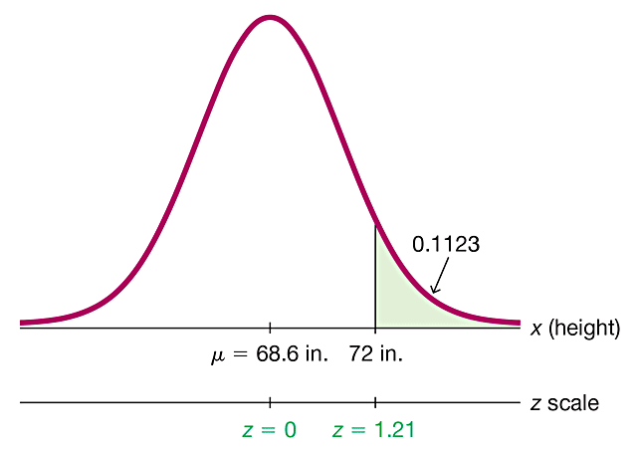
Example: What Proportion of Men Are Taller Than the 72 in. Height Requirement for Showerheads? (2 of 6)
Solution
Step 1: Men have heights that are normally distributed with a mean of 68.6 in. and a standard deviation of 2.8 in. The shaded region represents the men who are taller than the showerhead height of 72 in.

Slide 9
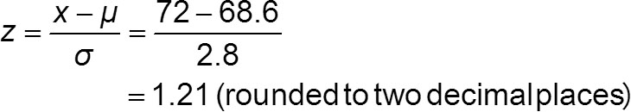
Example: What Proportion of Men Are Taller Than the 72 in. Height Requirement for Showerheads? (3 of 6)
Solution
Step 2: We can convert the showerhead height of 72 in. to the z score of 1.21 by using the conversion formula as follows:

Slide 10
Example: What Proportion of Men Are Taller Than the 72 in. Height Requirement for Showerheads? (4 of 6)
Solution
Step 3: Technology: Technology can be used to find that the area to the right of 72 in. in the figure is 0.1123 rounded. (With many technologies, Step 2 can be skipped.) The result of 0.1123 from technology is more accurate than the result of 0.1131 found by using Table A-2.

Slide 11
Example: What Proportion of Men Are Taller Than the 72 in. Height Requirement for Showerheads? (5 of 6)
Solution
Table A-2: Use Table A-2 to find that the cumulative area to the left of z = 1.21 is 0.8869. (Remember, Table A-2 is designed so that all areas are cumulative areas from the left.) Because the total area under the curve is 1, it follows that the shaded area is 1 − 0.8869 = 0.1131.

Slide 12
Example: What Proportion of Men Are Taller Than the 72 in. Height Requirement for Showerheads? (6 of 6)
Interpretation
The proportion of men taller than 72 in. is 0.1123, or 11.23%. About 11% of men may find the design to be unsuitable.

Slide 13
Finding Values From Known Areas (1 of 3)
Here are helpful hints for those cases in which the area (or probability or percentage) is known and we must find the relevant value(s):
Graphs are extremely helpful in visualizing, understanding, and successfully working with normal provability distributions, so they should always be used.

Slide 14
Finding Values From Known Areas (2 of 3)
​​Don’t confuse z scores and areas. z scores are distances along the horizontal scale, but areas are regions under the normal curve. Table A-2 lists z scores in the left columns and across the top row, but areas are found in the body of the table.
​​Choose the correct (right/left) side of the graph. A value separating the top 10% from the others will be located on the right side of the graph, but a value separating the bottom 10% will be located on the left side of the graph.

Slide 15
Finding Values From Known Areas (3 of 3)
A z score must be negative whenever it is located in the left half of the normal distribution.
Areas (or probabilities) are always between 0 and 1, and they are never negative.

Slide 16
Procedure For Finding Values From Known Areas or Probabilities (1 of 2)
Sketch a normal distribution curve, enter the given probability or percentage in the appropriate region of the graph, and identify the x value(s) being sought.
If using technology, refer to the instructions at the end of this section. If using Table A-2, refer to the body of Table A-2 to find the area to the left of x, then identify the z score corresponding to that area.

Slide 17

Procedure For Finding Values From Known Areas or Probabilities (2 of 2)
If you know z and must convert to the equivalent x value, use the conversion formula by entering the values for μ, σ, and the z score found in step 2, and then solve for x. We can solve for x as follows:
(Another form of the conversion formula)
Refer to the sketch of the curve to verify that the solution makes sense in the context of the graph and in the context of the problem.

Slide 18
Example: Designing an Aircraft Cockpit (1 of 7)
When designing equipment, one common criterion is to use a design that accommodates 95% of the population. We have seen that only 46% of women satisfy the height requirements for U.S. Air Force pilots. What would be the maximum acceptable height of a woman if the requirements were changed to allow the shortest 95% of women to be pilots? That is, find the 95th percentile of heights of women.
Assume that heights of women are normally distributed with a mean of 63.7 in. and a standard deviation of 2.9 in. In addition to the maximum allowable height, should there also be a minimum required height? Why?

Slide 19
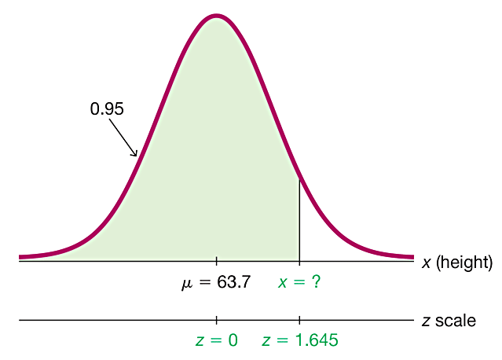
Example: Designing an Aircraft Cockpit (2 of 7)
Solution
Step 1: The figure shows the normal distribution with the height x that we want to identify. The shaded area represents the shortest 95% of women.

Slide 20
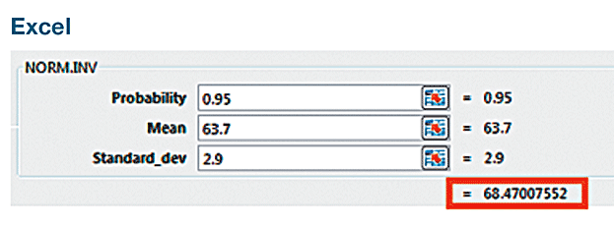
Example: Designing an Aircraft Cockpit (3 of 7)
Solution
Step 2: Technology: Technology will provide the value of x. For example, see the accompanying Excel display showing that x = 68.47007552 in., or 68.5 in. when rounded.

Slide 21
Example: Designing an Aircraft Cockpit (4 of 7)
Solution
Table A-2: If using Table A-2, search for an area of 0.9500 in the body of the table. (The area of 0.9500 shown in the figure is a cumulative area from the left, and that is exactly the type of area listed in Table A-2.)

Slide 22
Example: Designing an Aircraft Cockpit (5 of 7)
Solution
The area of 0.9500 is between the Table A-2 areas of 0.9495 and 0.9505, but there is an asterisk and footnote indicating that an area of 0.9500 corresponds to z = 1.645.

Slide 23

Example: Designing an Aircraft Cockpit (6 of 7)
Solution
Step 3: With z = 1.645, μ = 63.7 in., and σ = 2.9 in., we can solve for x by using the conversion formula:
The result of x = 68.4705 in. can be found directly or by using the following version of the conversion formula:

Slide 24
Example: Designing an Aircraft Cockpit (7 of 7)
Solution
Step 4: The solution of x = 68.5 in. is reasonable because it is greater than the mean of 63.7 in.
Interpretation
A requirement of a height less than 68.5 in. would allow 95% of women to be eligible as U.S. Air Force pilots. There should be a minimum height requirement so that the pilot can easily reach all controls.

